Slide 1
NCSES Product Innovation
ALAN WANG STEVE ZHOU
Mentor: Neil Alex
UVA-BI-SDAD
Notes:
National Center for Science and Engineering Statistics

Slide 2
Background and Motivation
How can we aid in the tracking of US economic activity for business innovation using non-traditional data sources such as opportunity and administrative data?
To achieve this, we need to develop a way to acquire opportunity data, in our case, news articles, ideally using a free and open-source tool.
Notes:
"Opportunity Data. Opportunity data is defined as data generated on an ongoing basis as society moves through its daily paces. Opportunity data is derived from a variety of sources such as GPS systems and embedded sensors, social media exchanges, mobile and wearable devices, and Internet entries. Captured through a variety of methods including direct flows, Internet searches, web crawling and scraping, these data may exist in a variety of electronic and physical modalities. Though technological advances allow users to collect volumes of data opportunistically, these collections are likely to be the least understood and studied."
"Administrative Data. Administrative data, also called “business practice” data, provides an opportunity for gathering information that exists due to normal economic activity and can be repurposed to supplement surveys in measuring innovation (National Research Council 2014). Administrative data can include a firm’s accounting records, patent and trademark databases, and 2 reports on innovation, and are available from the firm directly, publicly on the web, or from third parties (National Research Council 2014)."

Slide 3
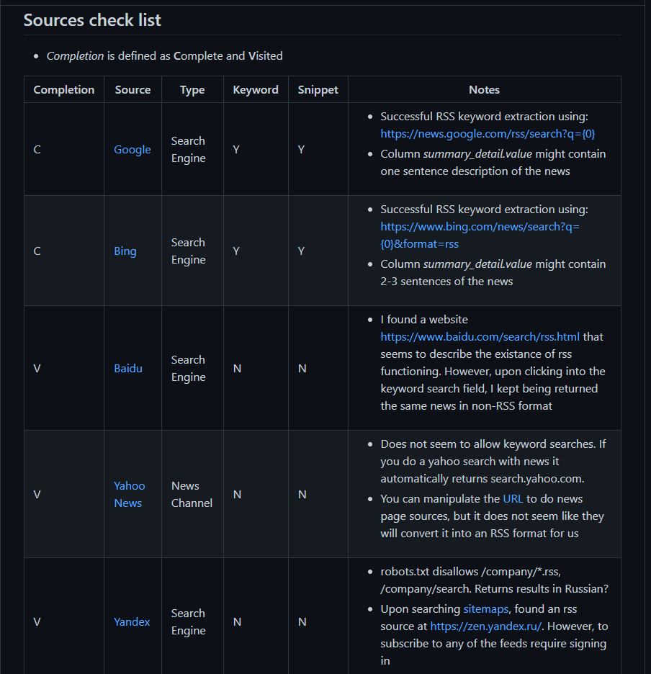
Challenges
Not all RSS search engines equal
Notes:
BII - From molecules to policy!
SDAD is an intentional collection of statistical sciences and social and behavioral sciences with a common interest in studying the social condition at scale.
Welcome to the Biocomplexity Institute and the Social and Decision Analytics Division.
how to frame it, how to teach it, how to make it integral to your work – how can data inform your decisions?
Unique Institute in the University of Virginia.
We have the same stature as other UVA schools with reporting lines directly to the Provost.
The range of our research is very exciting
The range is from mathematical biocomplexity around theoretical mathematics focusing on genomics and sequencing.
We then move from the molecular level and scale to other behavior scales and massive simulations around people, and movements of people throughout time and place – this is the work done by the NSSAC division. They created the COVID modeling that supported the governors of Virginia and New York and many others who used the data to make predictions about their workplace, industry, or customers.
As we scale to evidenced based policy, you start to engage with the research of our division. Because of this rich strong policy focus, we are located in Northern Virginia to be in the policy capital of the world and we are keeping our eyes wide open on how to bring our work to bear on important public policy. That is us!

Slide 4
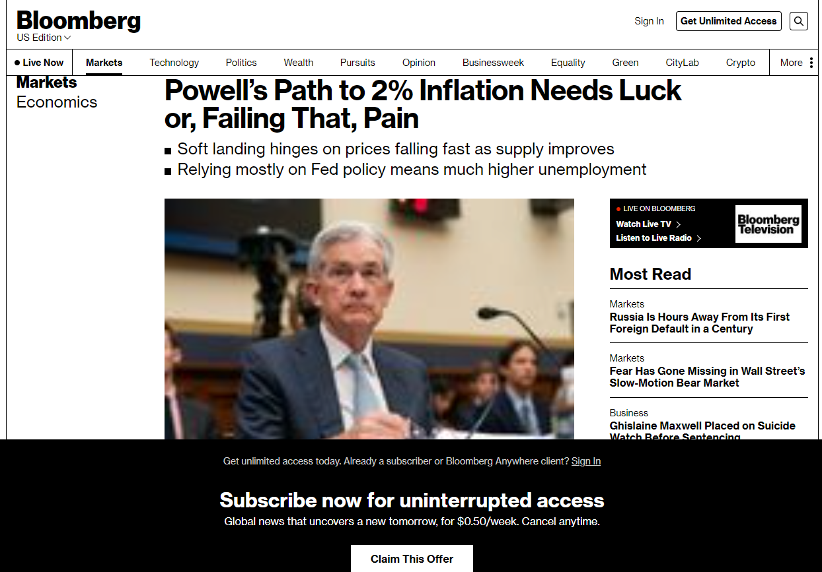
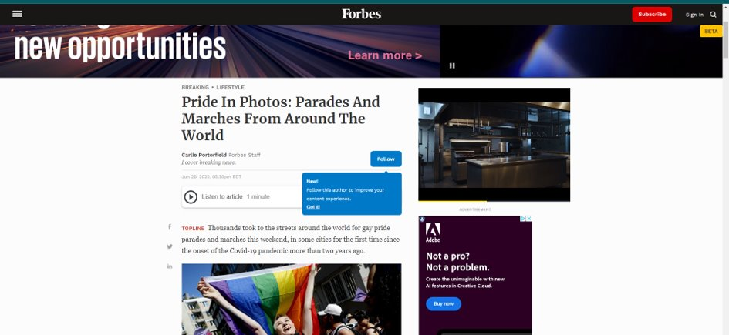
Challenges
Original text is hard to extract out of websites
Ads and other elements
are embedded with the text
Access are locked
behind paywalls

Slide 5
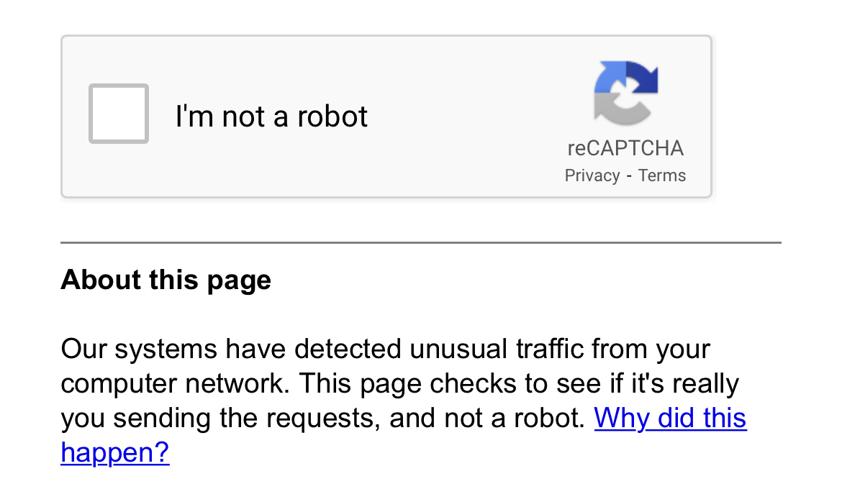
Challenges
Querying the same site too much or using VPN can get you IP banned CAPTCHA'ed

Slide 6
Methodology
Extract rss feeds using Google
Assign different severity to the extraction of original (optional: summarized text) given the URL
Leave a minimal footprint on the website's normal traffic
Notes:
Optional: apply pre-trained LSA summarizer to condense info

Slide 7
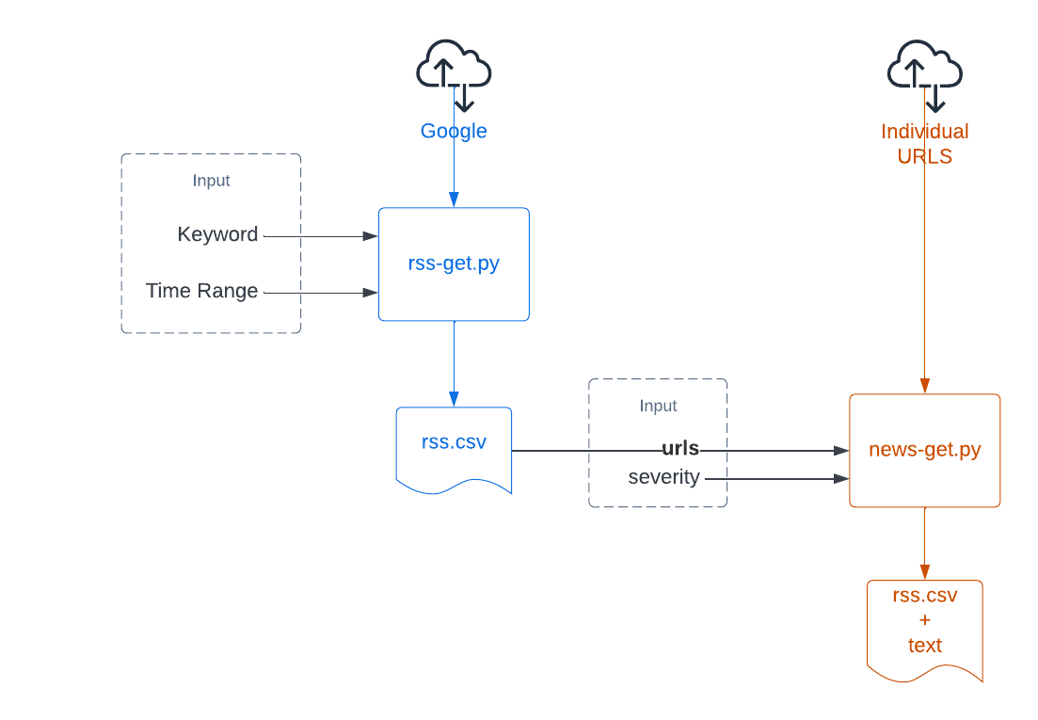
System Overview
Notes:
BII - From molecules to policy!
SDAD is an intentional collection of statistical sciences and social and behavioral sciences with a common interest in studying the social condition at scale.
Welcome to the Biocomplexity Institute and the Social and Decision Analytics Division.
how to frame it, how to teach it, how to make it integral to your work – how can data inform your decisions?
Unique Institute in the University of Virginia.
We have the same stature as other UVA schools with reporting lines directly to the Provost.
The range of our research is very exciting
The range is from mathematical biocomplexity around theoretical mathematics focusing on genomics and sequencing.
We then move from the molecular level and scale to other behavior scales and massive simulations around people, and movements of people throughout time and place – this is the work done by the NSSAC division. They created the COVID modeling that supported the governors of Virginia and New York and many others who used the data to make predictions about their workplace, industry, or customers.
As we scale to evidenced based policy, you start to engage with the research of our division. Because of this rich strong policy focus, we are located in Northern Virginia to be in the policy capital of the world and we are keeping our eyes wide open on how to bring our work to bear on important public policy. That is us!

Slide 8
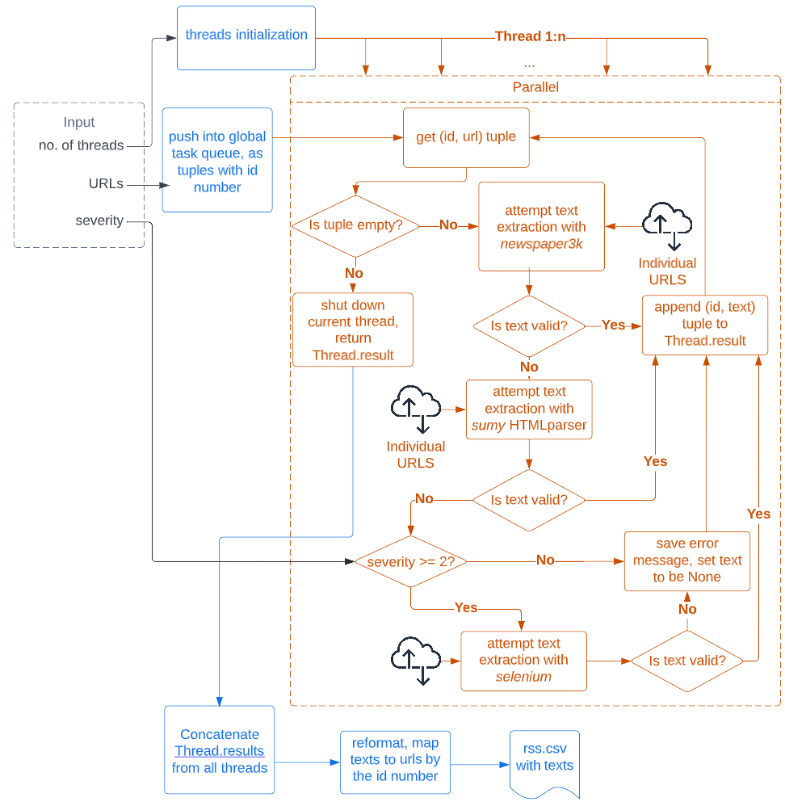
NEWS-GET
Notes:
How news-get.py works
Note: Threads, 3 attempted packages, TIME.SLEEP, organize data by id number

Slide 9
EVALUATION: SEVERITY
Severity 1 attempts to download .html directly
Severity 2 uses Selenium and webdriver, allowing pages to fully load
For websites requiring membership, we do not fake credentials
Notes:
CPU usage, running time, evaluation with success rate
Severity 1: 88.20%, 3 min 2 sec
Severity 2: 92.40%, 7 min 22 sec

Slide 10
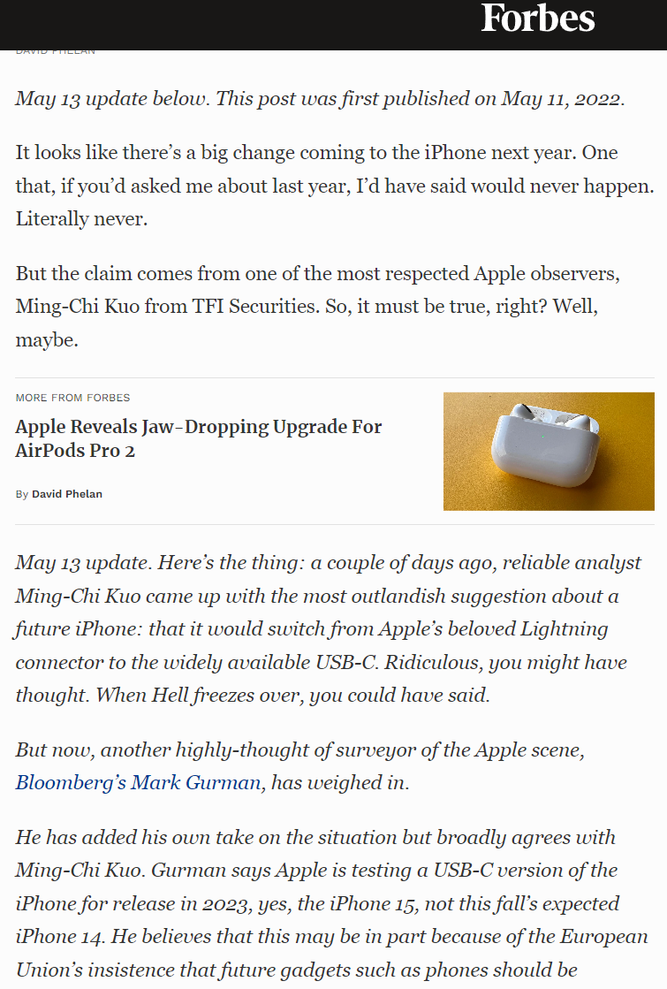
EVALUATION: NEWS
Each retrieved text is checked before storing in .csv
  Must be longer than a certain threshold, must not be a CAPTCHA prompt, etc.
But some in-line ads cannot be automatically distinguished
  Distorts summarizer particularly
Notes:
Creating the Science of Data by working very applied problems across all sectors. Industry, DOD, especially the US Army, Federal Statistical Agencies and local govts.
NOTE – Industry include P&G, MITRE, GT

Slide 11
FUTURE WORK
Build keyword list for pharmaceutics and more industries
Scale up test data sets and cross validate with SDAD’s existing data
Fine Tuning the scrapper and make publicly available
Train NLP model to grab information of production innovation from the texts
Notes:
Set this us as an example to use to highlight the next slides.
Say a couple of words on

